Slide 1
Cervical Spine Precautions & Cervical Collar Basics
Northwestern EM ortho curriculum

Slide 2
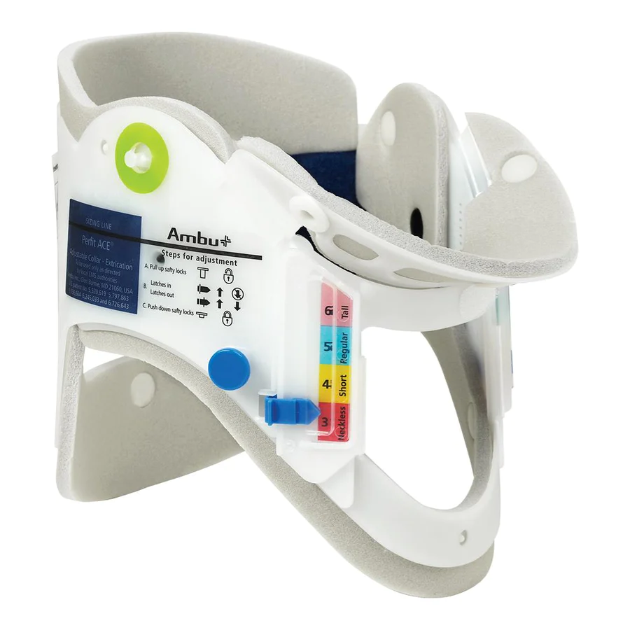
What is a Cervical Collar (C-Collar)?
A medical device worn around the neck to support and immobilize the cervical spine
Also known as a “neck brace”
Frequently worn after trauma, surgery, or for acute pain
Examples:
Semi-rigid “trauma” collar
Inexpensive (~$10), common, easily adjustable
Common brand names: Ambu, Laerdal
Cushioned, sizable cervical collar
Increased comfort and lower risk of skin breakdown with long-term wear, multiple sizes, costlier (~$50-100)
Common brand names: Aspen Vista, Ossur Miami J
Soft collar
Not an immobilization device
For patient comfort, avoid long-term use to avoid worsening stiffness & muscle atrophy

Slide 3
Initial Considerations for C-Collar Placement
Trauma
Not routinely recommended for neurologically intact patients with penetrating trauma
Currently recommended for some patients with blunt traumatic injury
Emergency Medical Services (EMS) will likely place a c-collar +/- rigid backboard on any patient presenting immediately after a blunt traumatic injury with significant mechanism
Rigid backboards are for transport only and should be removed on arrival to the ED
Cause discomfort and can lead to skin breakdown fairly quickly if not removed
Additional items also used by EMS, such as tape and blocks around the head and neck, can be also be removed by clinicians in ED

Slide 4
Indications for C-Collar Placement
Best practices and indications for c-collar placement on individual patients are debated and require best judgment by a trained clinician based on the clinical situation
In general, if a c-collar is not placed in the field or a patient is brought in by private vehicle, a clinician should use clinical judgment and consider applying to the following patient populations:
Patients with a neurologic deficit on exam
Patients suffering from blunt trauma and with:
Unstable vitals signs
Altered mental status (GCS ≤ 14)
Evidence of facial or neck injuries
Significant neck pain
Inability to complete neurologic exam based on patient factors (intoxication, altered mental status)
Advanced age or frailty (as determined by physician discretion)
Patients who arrive ambulatory, neurologically intact, without c-collar in place, or those who have delayed presentations after traumatic injury are unlikely to benefit from c-collar placement

Slide 5
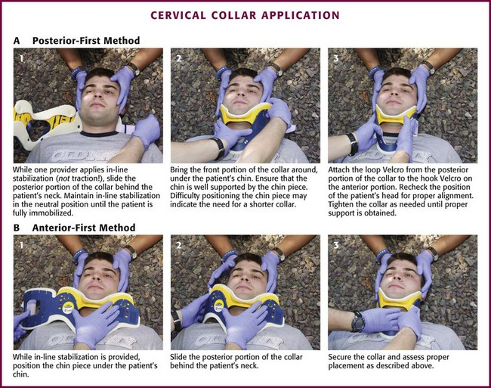
Technique for C-Collar Placement

Slide 6
Technique for C-Collar Placement
If possible, have two clinicians available for placement – one to hold in-line stabilization of the cervical spine and one to apply the collar
Patient will be lying flat on a bed and/or board
If an adjustable collar is used, the most inferior portion of the collar should lie flush with the upper chest and the most superior portion will be tight against the chin
Instruct patient not to move their head
Press down on the cushioning of the bed on one side of the patient’s neck
Use the space created to slide through the posterior flap of the c-collar
Flip out the chin rest and bend the anterior flap of the c-collar around the patient’s neck – this step is frequently forgotten, resulting in the collar digging into the patient’s chin
Tighten the Velcro strap for snug fit

Slide 7
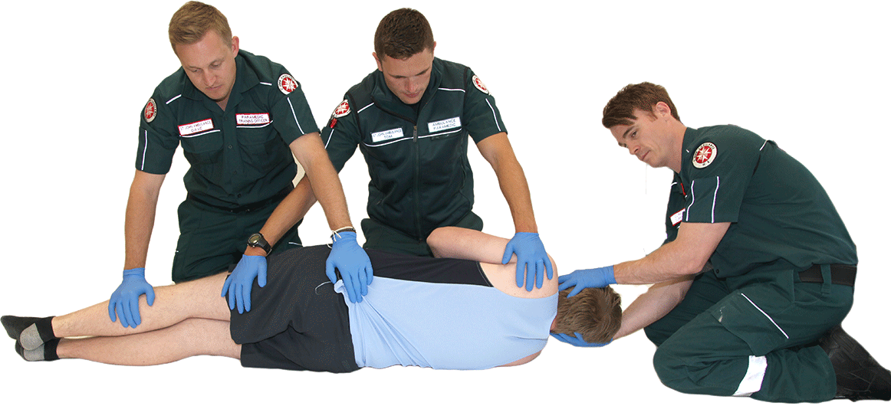
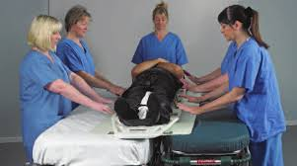
Mobility for a Patient with Suspected Cervical Spine Injury
Have at least three people available to assist
Instruct patient not to move
Have trained clinician hold inline immobilization of the cervical spine
Recommendation: Person at head of bed, who is holding inline stabilization, should count out loud (“1,2,3”) to help coordinate synchronized log roll and patient transfer
Have two additional clinicians turn the patient utilizing log roll technique
Hard backboard can be removed when patient is on their side
Patients often feel like they are “falling” when board is removed, warn them of this ahead of time
During a trauma workup/secondary survey, this technique can be used to facilitate examination of the back and palpation of the thoracic and lumbar spine
Place patient on a flexible backboard for transfers, remove once transfer is complete
Return patient to lying position with synchronized, slow lowering
Head of bed can again count out load to coordinate this movement
Log roll technique
Transfer using backboard

Slide 8
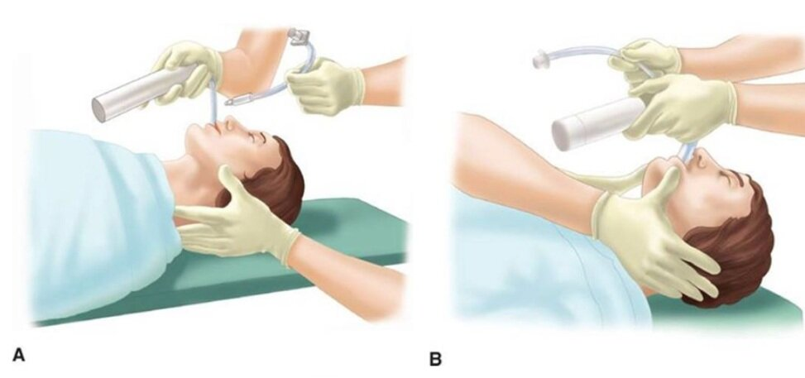
Inline C-Spine Stabilization during Intubation
The first step in management of trauma patients is assessing and securing their airway
This may require endotracheal intubation
Studies have shown that it is more difficult to successfully intubate a patient wearing a rigid c-collar
Removal of the c-collar and manual in-line stabilization (MILS) is recommended to increase chance of successful intubation
There are two most common techniques
Both require a second clinician, who:
Crouches next to the patient and intubating clinician, holding the occiput on both sides of the head
Stands facing the intubating clinician, holding forearms against the patient’s chest with fingers extending to both sides of the head

Slide 9
Cervical Spine Clearance and C-Collar Removal
How?
Use clinical decision rules
Canadian C-Spine Rule (CCR)
NEXUS
Obtain imaging, if necessary
CT cervical spine without contrast
If positive imaging findings:
Remain in c-collar with precautions
Involve consultants
If negative imaging and resolved pain:
Remove c-collar

Slide 10
C-Collar Removal for Patient with Persistent Pain
Persistent c-spine tenderness after negative imaging is a common issue in trauma patients
One study suggested a majority of patients without reported head or neck trauma will have midline cervical spine tenderness
Recommendations for management in this patient population vary, with the majority of societies suggesting one of the following:
Obtain MRI cervical spine
Discharge patient in cervical collar and set up follow-up in two weeks
Clear cervical spine and remove collar if negative CT imaging, even with persistent pain
Because of the lack of consensus in best clinical practice, nearly every trauma center has guidelines for management of these patients
Clinicians should consult their institutional guidelines and use best clinical judgment in this patient population

Slide 11
References
Sources:
Buck A, Colwell C. The Great C-Collar Debate. EM:RAP. https://www.emrap.org/episode/januaryhotsheet/thegreatccollar. Published January 1, 2017. Accessed December 13, 2022.
Cervical Spine Packet. Henry Mayo. https://www.henrymayo.com/. Published November 1, 2015. Accessed December 13, 2022.
Coffey F, Hewitt S, Stiell I, et al. Validation of the Canadian c-spine rule in the UK emergency department setting. Emerg Med J. 2011;28(10):873-876. doi:10.1136/emj.2009.089508
Deasy C, Cameron P. Routine application of cervical collars--what is the evidence?. Injury. 2011;42(9):841-842. doi:10.1016/j.injury.2011.06.191
Delaney JS, Al-Kashmiri A, Alalshaikh A, Al-Ghafri S, Saluja SS, Correa JA. Prevalence of midline cervical spine tenderness in the non-trauma population. Emerg Med J. 2022;39(4):308-312. doi:10.1136/emermed-2021-211288
Hoffman JR, Mower WR, Wolfson AB, Todd KH, Zucker MI. Validity of a set of clinical criteria to rule out injury to the cervical spine in patients with blunt trauma. National Emergency X-Radiography Utilization Study Group [published correction appears in N Engl J Med 2001 Feb 8;344(6):464]. N Engl J Med. 2000;343(2):94-99. doi:10.1056/NEJM200007133430203
Kwan I, Bunn F, Roberts I. Spinal immobilisation for trauma patients. Cochrane Database Syst Rev. 2001;2001(2):CD002803. doi:10.1002/14651858.CD002803
Orman R, Colwell C. Do we still need the C-collar? EM:RAP. https://www.emrap.org/episode/feb2016emrap/dowestillneed. Published February 6, 2016. Accessed December 13, 2022.
[Peer-Reviewed, Web Publication] Levine, D. Schmitz, Z. (2021, Oct 18). C-Spine. [NUEM Blog. Expert Commentary by Levine, M]. Retrieved from http://www.nuemblog.com/blog/cervical-spine-intubation
Stiell IG, Clement CM, O'Connor A, et al. Multicentre prospective validation of use of the Canadian C-Spine Rule by triage nurses in the emergency department. CMAJ. 2010;182(11):1173-1179. doi:10.1503/cmaj.091430
Stiell IG, Wells GA, Vandemheen KL, et al. The Canadian C-spine rule for radiography in alert and stable trauma patients. JAMA. 2001;286(15):1841-1848. doi:10.1001/jama.286.15.1841
Tienpratarn W, Yuksen C, Aramvanitch K, et al. Success Rate of Endotracheal Intubation Using Inline Stabilization with and without Cervical Hard Collar; a Comparative Study. Arch Acad Emerg Med. 2020;8(1):e81. Published 2020 Oct 10.
Tran J, Jeanmonod D, Agresti D, Hamden K, Jeanmonod RK. Prospective Validation of Modified NEXUS Cervical Spine Injury Criteria in Low-risk Elderly Fall Patients. West J Emerg Med. 2016;17(3):252-257. doi:10.5811/westjem.2016.3.29702
Vaillancourt C, Charette M, Sinclair J, et al. Implementation of the Modified Canadian C-Spine Rule by Paramedics [published online ahead of print, 2022 Oct 31]. Ann Emerg Med. 2022;S0196-0644(22)01030-7. doi:10.1016/j.annemergmed.2022.08.441
Velopulos CG, Shihab HM, Lottenberg L, et al. Prehospital spine immobilization/spinal motion restriction in penetrating trauma: A practice management guideline from the Eastern Association for the Surgery of Trauma (EAST). J Trauma Acute Care Surg. 2018;84(5):736-744. doi:10.1097/TA.0000000000001764
Images and Videos:
https://meditackits.com/products/ambu-perfit-ace-adjustable-collar?variant=42644348403965&currency=USD&utm_medium=product_sync&utm_source=google&utm_content=sag_organic&utm_campaign=sag_organic&gclid=CjwKCAiA-dCcBhBQEiwAeWidtd2NyM_Rk7KUuJE1djAr0hCt8uc5te8y1SvhCEn_XX8XuGYVHiCbUhoCgeoQAvD_BwE
https://www.alimed.com/aspen-collars.html
https://veteriankey.com/prehospital-immobilization/
https://www.youtube.com/watch?v=tzobASnovRc
https://clinical.stjohnwa.com.au/clinical-skills/trauma/spinal-precautions-immobilisation/log-roll
https://www.mascip.co.uk/wp-content/uploads/2015/02/MASCIP-SIA-Guidelines-for-MH-Trainers.pdfd
https://www.mdcalc.com/calc/696/canadian-c-spine-rule#use-cases
https://www.mdcalc.com/calc/703/nexus-criteria-c-spine-imaging
https://doctorlib.info/pediatric/schafermeyers-pediatric-emergency-medicine/24.htm

