Slide 1
Upper Extremity H&P: Elbow Exam
WEEK 1 ORTHO CURRICULUM

Slide 2
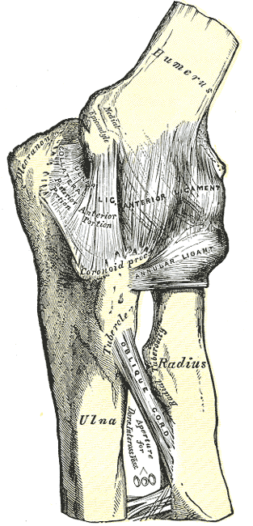
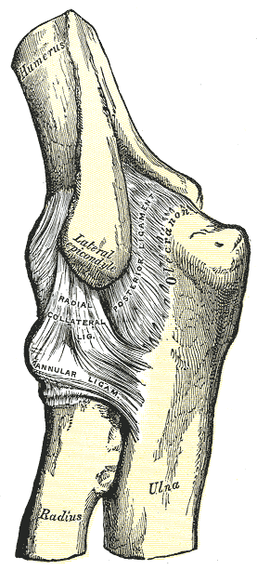
General Ortho Physical Exam Maneuvers
Inspection
Palpation
Range of Motion
Muscle Strength
Special Tests
Always think about the joint above and below where the pain is and examine that joint

Slide 3
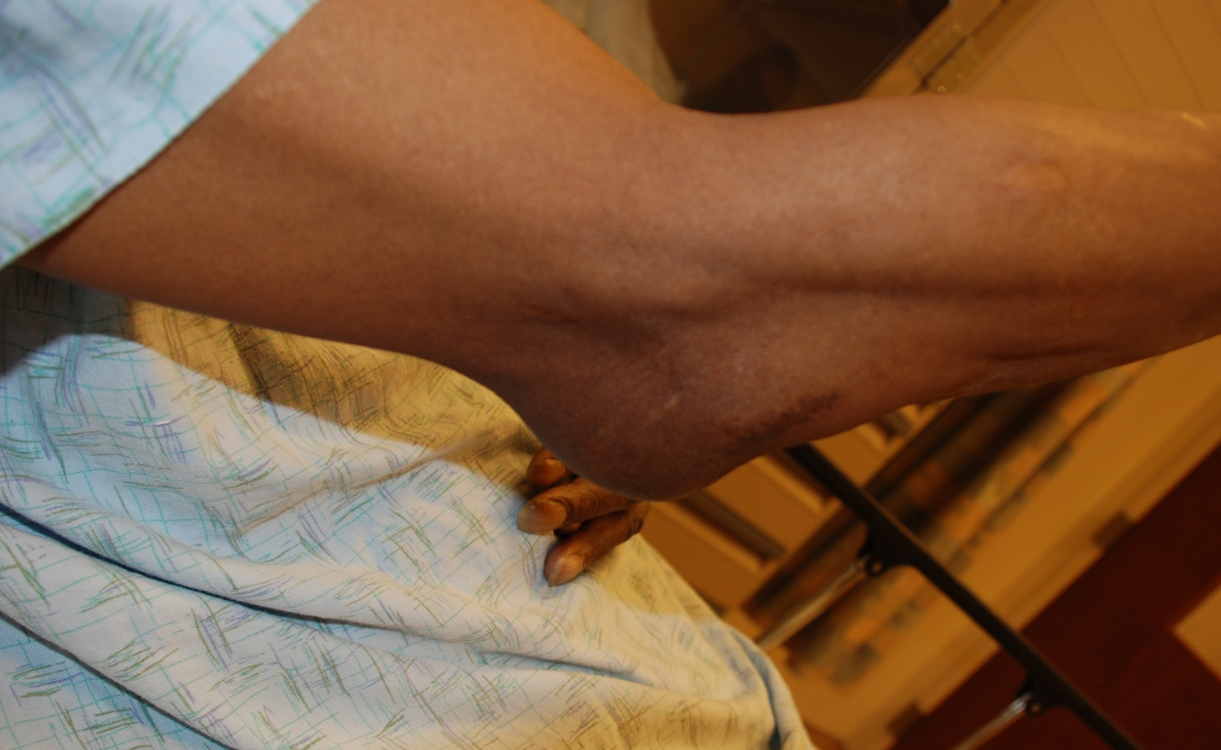
INSPECTION
Look for redness, swelling, warmth -> think septic arthritis
Look at olecrenon bursa – should see bony prominence
If looks boggy or like a golf ball -> think bursitis
Olecrenon bursitis

Slide 4
PALPATION
Olecrenon: should be bony, if boggy, warm -> think bursitis
Epicondyles: should be prominent
Radial Head: very important because many occult fractures
Palpate distal to the lateral epicondyle on the radial side, then pronate and supinate and should feel the radial head moving under fingers –> look for pain which may indicate radial head fx

Slide 5
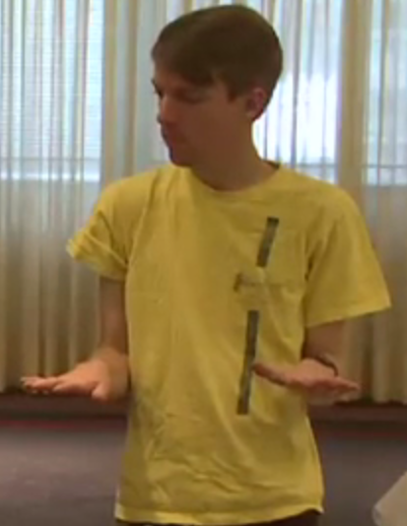
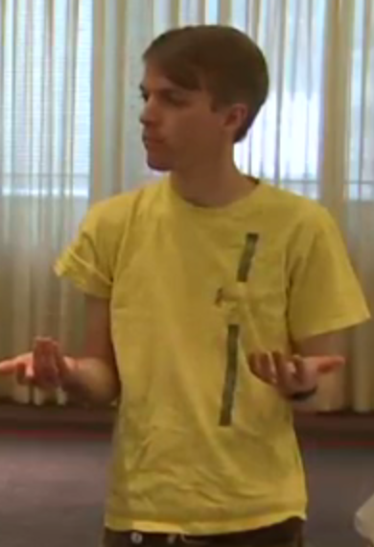
RANGE OF MOTION
Elbow Flexion: 135º
Elbow Extension: 0º
Pronation (palms down)
Supination (palms up)

Slide 6
STRENGTH TESTING
Resisted forearm flexion/extension
Resisted wrist extension/flexion
Resisted long finger extension
Pain at elbow with resisted forearm/wrist/finger extension -> may be lateral epicondylitis
Pain at elbow with resisted forearm/wrist flexion -> may be medial epicondylitis

Slide 7
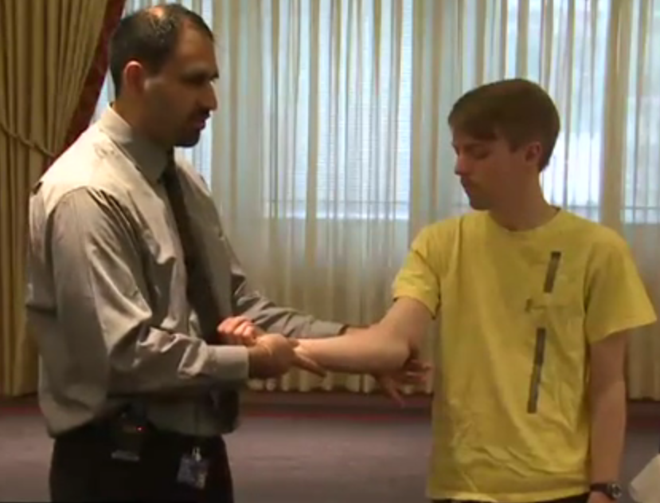
SPECIAL TESTS
Rupture of Ulnar Collateral Ligament (rare)
UCL is on the medial aspect of the elbow
Valgus stress – arm in partial extension, stress on the lateral aspect of the elbow, opens up the medial joint space -> pain may indicate rupture

