Slide 1
Lower Extremity H&P:
Foot/Ankle Exam
WEEK 1 ORTHO CURRICULUM

Slide 2
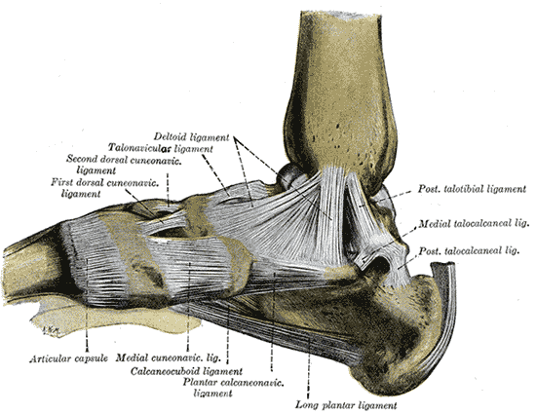
General Ortho Physical Exam Maneuvers
Inspection
Palpation
Range of Motion
Muscle Strength
Special Tests
Always think about the joint above and below where the pain is and examine that joint

Slide 3
INSPECTION
Look for redness, swelling, warmth -> think septic arthritis
Evaluate for effusion
Look for gross deformity

Slide 4
PALPATION
Medial and lateral malleoli
Palpate along the fibula to assess for tenderness, possible fibular fracture
Anterior and posterior talofibular ligaments, deltoid ligament, calcaneofibular ligament
Talar neck
Calcaneus
Mid-foot
5th metatarsal
  Consider Jones fracture – concern for avascular necrosis
Palpate the mid-foot, assessing for Lisfranc fracture

Slide 5
RANGE OF MOTION
Plantar flexion: 50 degrees
Dorsiflexion: 20 degrees
Foot inversion: 35 degrees
Foot eversion: 25 degrees

Slide 6
STRENGTH TESTING
Resisted plantar and dorsiflexion
Resisted inversion and eversion

Slide 7
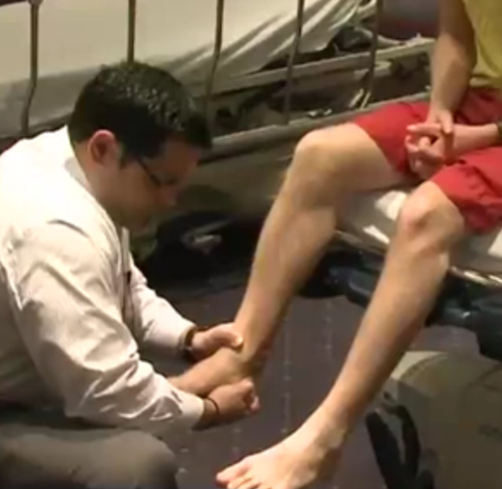
SPECIAL TESTS
Anterior drawer
  Assesses the anterior talofibular ligament
  Have the patient sit with the knee flexed over the edge of the table
  Stabilize the distal lower extremity with one hand and apply an anterior force to the heel with the other hand, attempting to subluxate the talus anteriorly
Talar tilt
  Evaluates for talar instability
  With the patient seated and with the ankle and foot unsupported in approx 15 degrees of plantar flexion, stabilize the medial aspect of the distal lower extremity and apply an inversion force to the hindfoot with the other hand
Thompson test
  Evaluates for Achilles tendon rupture
  With the patient prone, flex the knee to 90 degrees and squeeze the calf
  The foot should plantar flex – if it does not, suspect tendon injury
Anterior drawer

