Slide 1
Upper Extremity H&P:
Hand/Wrist Exam
Week 1 ortho curriculum

Slide 2
General Ortho Physical Exam Maneuvers
Inspection
Palpation
Range of Motion
Muscle Strength
Special Tests
Always think about the joint above and below where the pain is and examine that joint

Slide 3
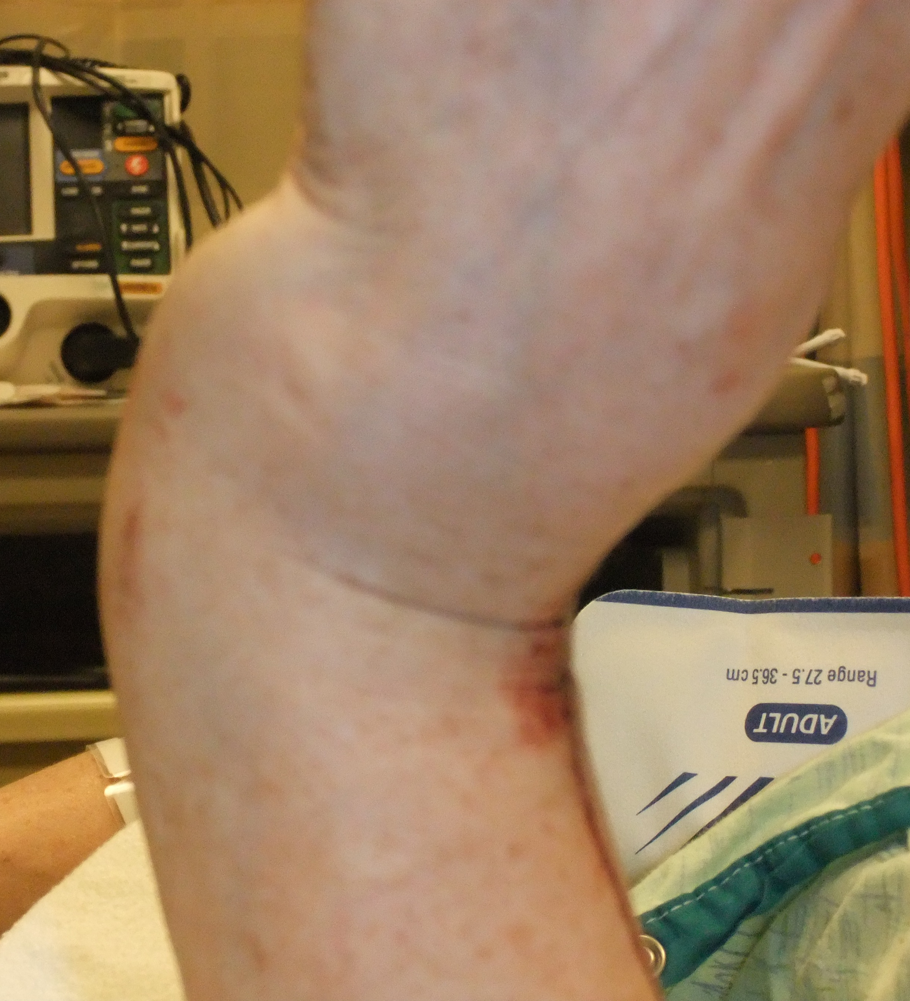
Inspection
Look for deformities
  Carpal dislocation
  Wrist fractures
Redness, warmth, swelling
  Septic arthritis

Slide 4
Palpation
Entire length of the radius and ulna
Ulnar styloid
  > 50% of radius fxs have associated ulnar styloid fx
Scaphoid
  In anatomic snuffbox -> spread fingers and extend thumb
  Also can axial load thumb and assess for tenderness
Distal 5th metacarpal
Proximal 2nd and 3rd metacarpals
Carpal rows
Neurovascular exam: distal pulses, capillary refill

Slide 5
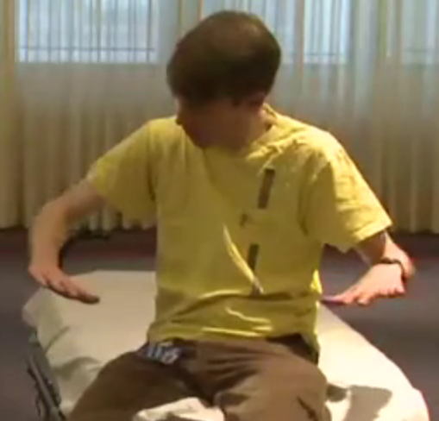
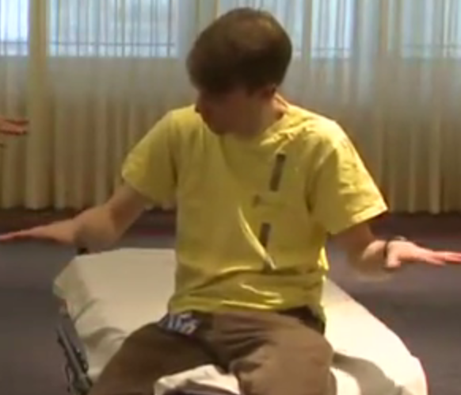
Range of Motion
Wrist Extension: 70-90º
Wrist Flexion: 70-80º
Radial and ulnar deviation
  Ulnar deviation: about 25º
  Ulnar deviation > radial deviation
Radial deviation
Ulnar deviation

Slide 6
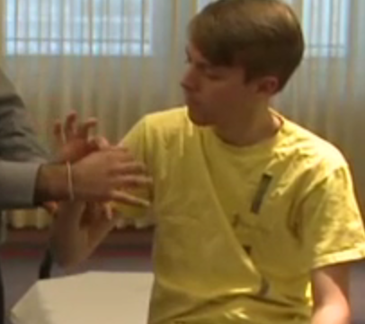
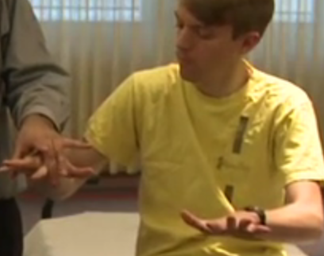
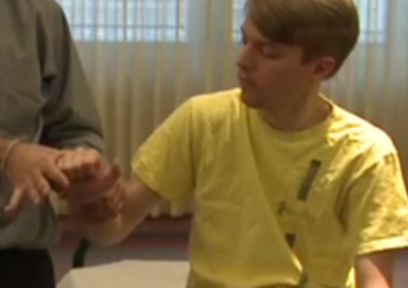
Strength Testing
Median nerve: okay sign against resistance
Ulnar nerve: intrinsic hand muscles: abduct fingers against resistance
Radial nerve: wrist extension against resistance

Slide 7
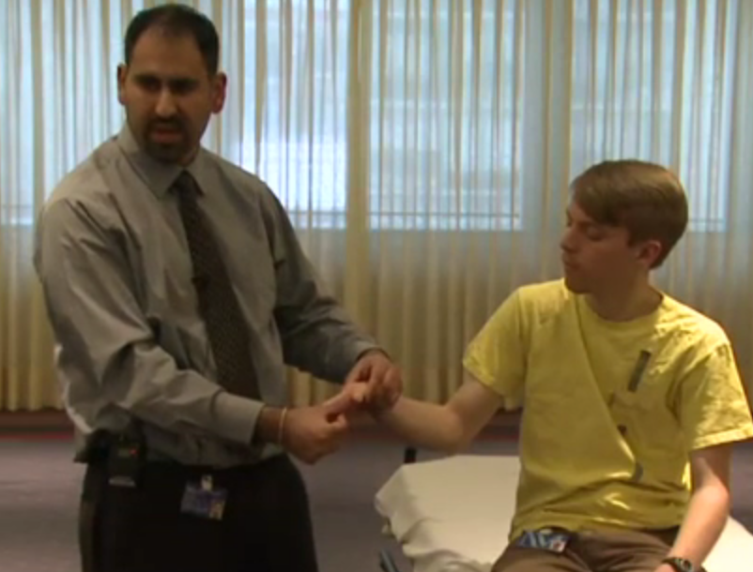
Special Tests: Gamekeeper’s Thumb
Ulnar collateral ligament injury at 1st metacarpal-phalangeal joint
  Classically: thumb got stuck in a ski pole
  Support the radial aspect of the thumb by placing your thumb on the patient’s distal thumb and stress the joint trying to open it up -> laxity or pain suggests injury

Slide 8
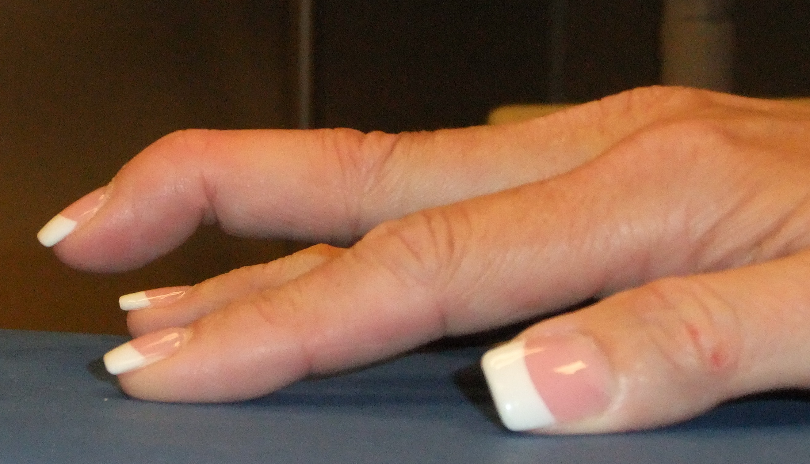
Special Tests: Jersey Finger and Mallet Finger
Jersey Finger: flexor tendon injury at DIP
  Can’t flex at DIP
  Urgent follow up
Mallet finger: extensor tendon injury at DIP
  Can’t extend at DIP
Mallet Finger

Slide 9
SPECIAL TESTS (CONT’D)
Tendon injuries (especially with lacerations)
  FDS -> flex at the PIP joint
  FDP -> immobilize PIP and flex at the DIP joint

