Slide 1
Lower Extremity H&P:
Hip Exam
WEEK 1 ORTHO CURRICULUM

Slide 2
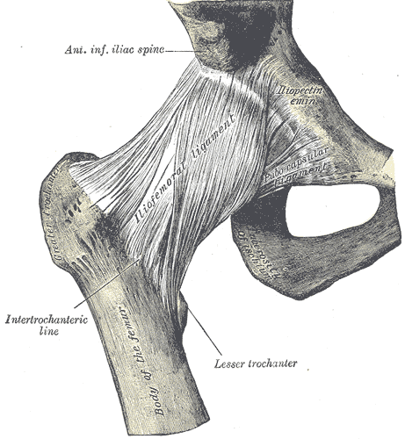
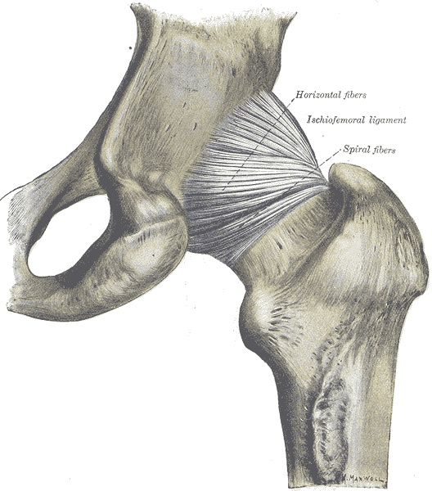
General Ortho Physical Exam Maneuvers
Inspection
Palpation
Range of Motion
Muscle Strength
Special Tests
Always think about the joint above and below where the pain is and examine that joint

Slide 3
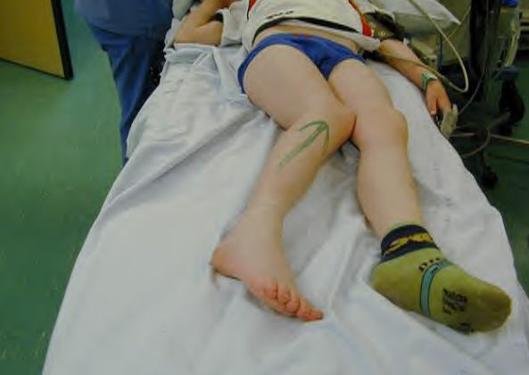
INSPECTION
Look for redness, swelling, warmth -> think septic arthritis
Examine the patient’s gait if possible
Evaluate leg length and alignment
  Posterior dislocation (90% of hip dislocations) – affected leg is shortened and internally rotated
  Anterior dislocation – affect leg is slightly shortened and externally rotated

Slide 4
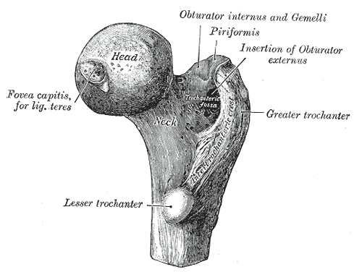
PALPATION
Palpate the ischial spines and pubic rami
Also assess the femur and knee for additional injuries
Palpate the greater trochanter and assess for bursitis
  While palpating the trochanter, gently rock the extended leg on the table from side to side to assess for trochanteric bursitis

Slide 5
RANGE OF MOTION
Flexion: 135 degrees
Extension: 15 degrees
External rotation: 45 degrees
Internal rotation: 35 degrees
Abduction, adduction
In a patient with severe pain, simply rock the affected leg from side to side on the exam table – if a patient is unable to tolerate this, suspect acute injury such as a hip fracture

Slide 6
STRENGTH TESTING
Resisted hip flexion
Resisted hip abduction and adduction
Resisted internal and external rotation

Slide 7
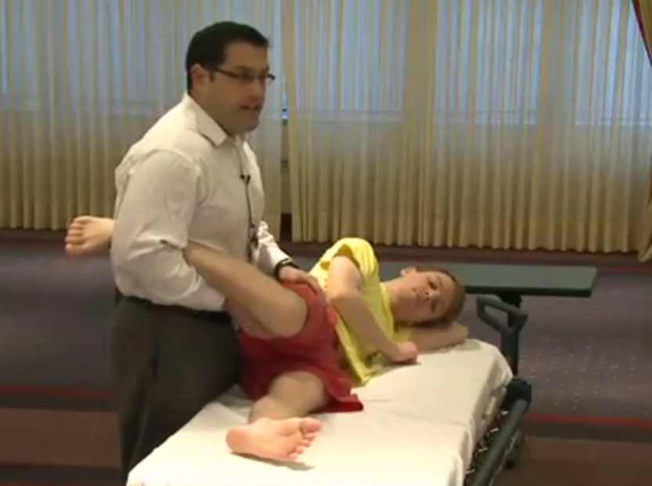
SPECIAL TESTS
Ober’s test – evaluates for tightness of the iliotibial band
  Have the patient lie on his unaffected side with the affected leg straight
  Stabilize the hip with one hand and use the other hand to lift the affected leg, bending the leg at the knee
  Allow the leg to drop
  If the leg does not fully adduct, the test is positive for tight IT band

