Slide 1
Lower Extremity H&P:
Knee Exam
WEEK 1 ORTHO CURRICULUM

Slide 2
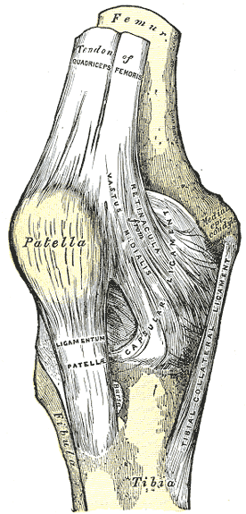
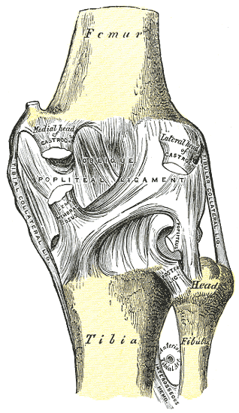
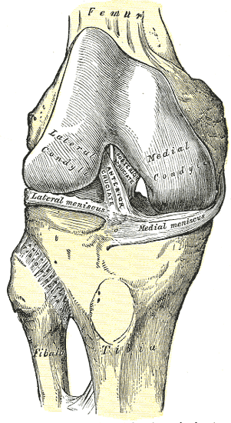
General Ortho Physical Exam Maneuvers
Inspection
Palpation
Range of Motion
Stability
Special Tests
Always think about the joint above and below where the pain is and examine that joint

Slide 3
INSPECTION
Look for redness, swelling, warmth -> think septic arthritis
Look for effusion – occurs in acute injury
  Is the effusion mild, moderate, or severe?
Look for displacement of the patella
Baker’s cyst – swelling over posterior aspect of the knee
Don’t forget to watch the patient walk
  Is the patient able to bear weight?
  Does the patient have an antalgic gait? (limping gait) Indicates pain with weight bearing

Slide 4
PALPATION
Grasp the lower extremity just distal to the knee and push upward, attempting to “milk” any effusion that may be present
  If there is a significant effusion, you will see it fill the crevices on the medial and lateral sides of the patella
Palpate the patella – should be mobile
Palpate the entire knee, looking for any point tenderness
  Evaluate joint line tenderness with the thumb

Slide 5
RANGE OF MOTION
Normal functional ROM
  3 degrees of hyperextension
  140 degrees of flexion
Always compare the symptomatic knee to the contralateral normal knee
Forced flexion
  Patient with a meniscal tear will be unable to tolerate
Limited extension – consider meniscal tear or effusion
Hyperextension – consider PCL tear

Slide 6
STABILITY
Lachman
  Evaluates for ACL injury
Posterior drawer
  Evaluates for PCL injury
Varus and valgus stress
  Evaluates for MCL, LCL injuries
McMurray
  Evaluates for meniscal injury

Slide 7
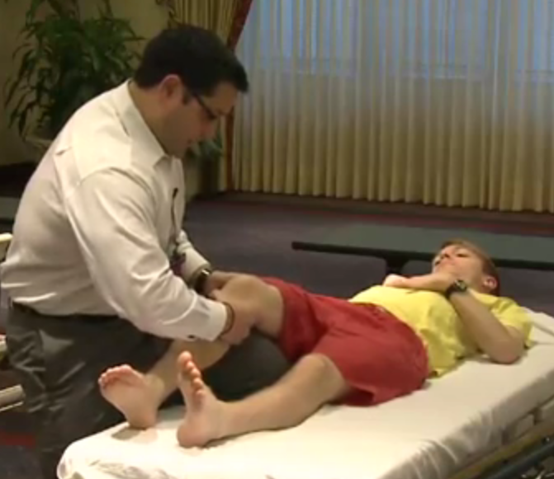
Lachman
With the knee flexed at 30 degrees, grasp the inner aspect of the calf with one hand, grasp outer aspect of distal thigh with the other hand
Pull on the tibia to assess the amount of anterior motion of the tibia in comparison to the femur
ACL injury – increased forward translation of the tibia at the end of movement

Slide 8
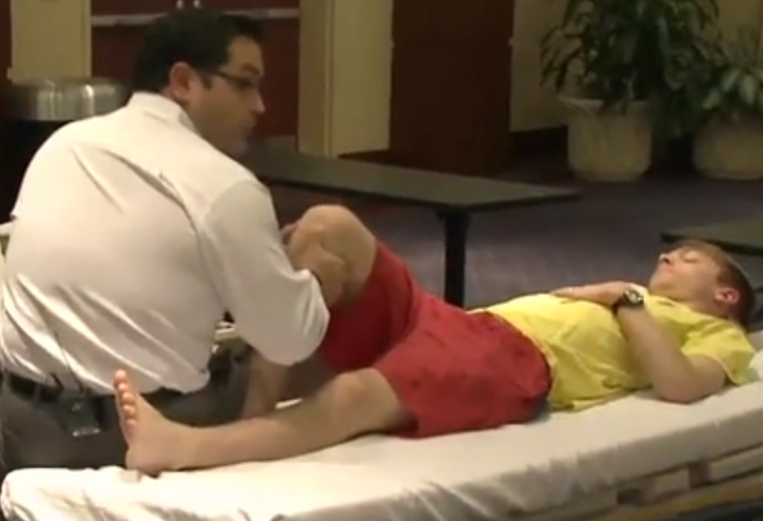
Posterior Drawer
With the knee flexed to 90 degrees and the patient’s foot flat on the table, grasp the tibia with both hands and push posteriorly
Laxity at the conclusion of movement is indicative of a PCL injury

Slide 9
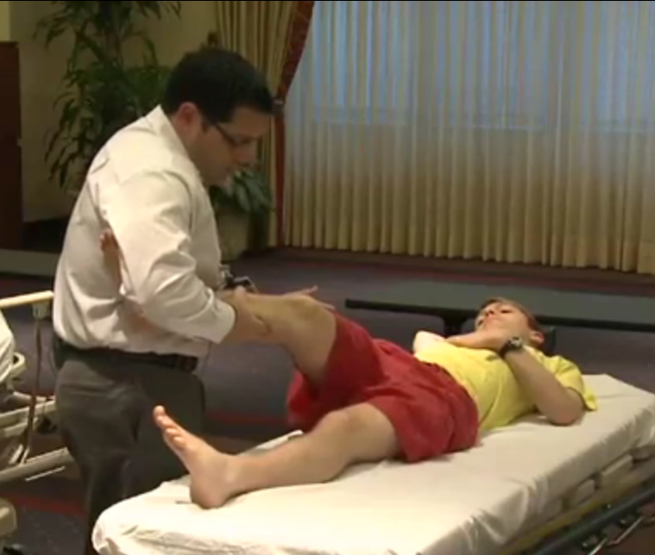
Varus and Valgus Stress
Place the patient’s leg over the examination table with one hand over the lateral joint line and the other hand holding the distal portion of the extremity
Flex the knee to 30 degrees and apply a varus force (adduction), then apply a valgus force (abduction)
Laxity with varus stress indicates LCL injury
Laxity with valgus stress indicates MCL injury

Slide 10
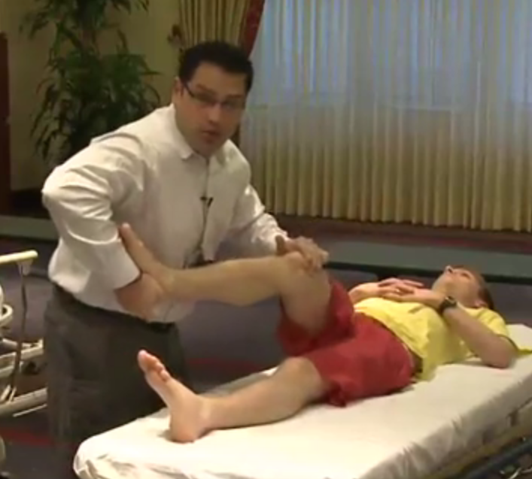
McMurray
With the knee flexed to 90 degrees, place one hand along the lateral joint line and grasp the foot with the other hand
Provide a varus stress on the knee
Rotate the leg externally and extend the knee
If the patient experiences pain or a click is felt with the motion, a medial meniscal injury should be suspected
A lateral meniscal injury can be evaluated with the same test by stabilizing the medial knee, internally rotating the leg and extending the knee

Slide 11
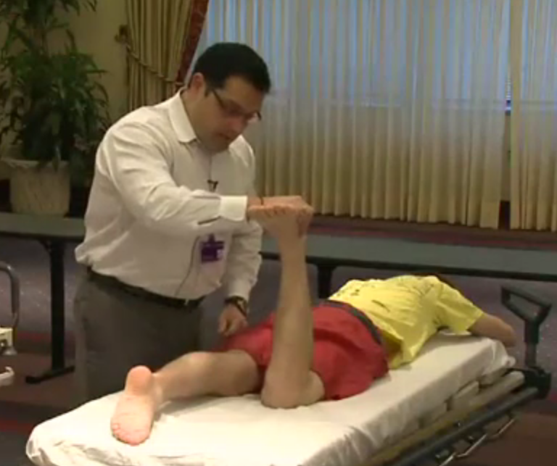
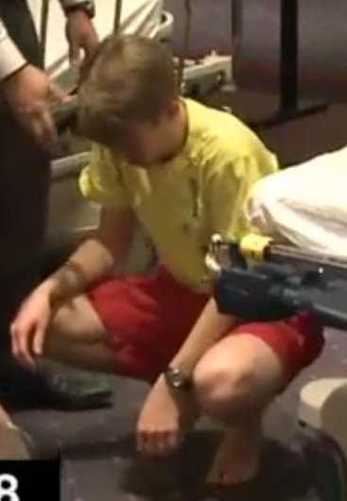
SPECIAL TESTS
Patellar apprehension test
  Manually subluxate the patella laterally
  In a pateller tendon injury, the patient will not tolerate this test
Patellar grind
  Have the patient flex his quadricep, then apply a posteriorly-directed force to the patella
Apley’s test
  With the patient prone, flex the affected knee to 90 degrees, grasp the foot and rotate the knee, applying a downward force
  Reproduction of pain indicates a meniscal injury
Duck walk
  Have the patient attempt to walk while in a squatting position
  If the patient is able to walk, he/she likely does not have a meniscal injury
Apley’s test
Duck walk

