Slide 1
Upper Extremity H&P: Shoulder Exam
Week 1 Ortho Curriculum

Slide 2
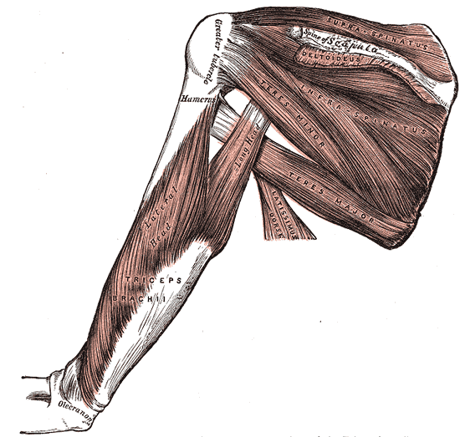
General Ortho Physical Exam Maneuvers
Inspection
Palpation
Range of Motion
Muscle Strength
Special Tests
Always think about the joint above and below where the pain is and examine that joint

Slide 3
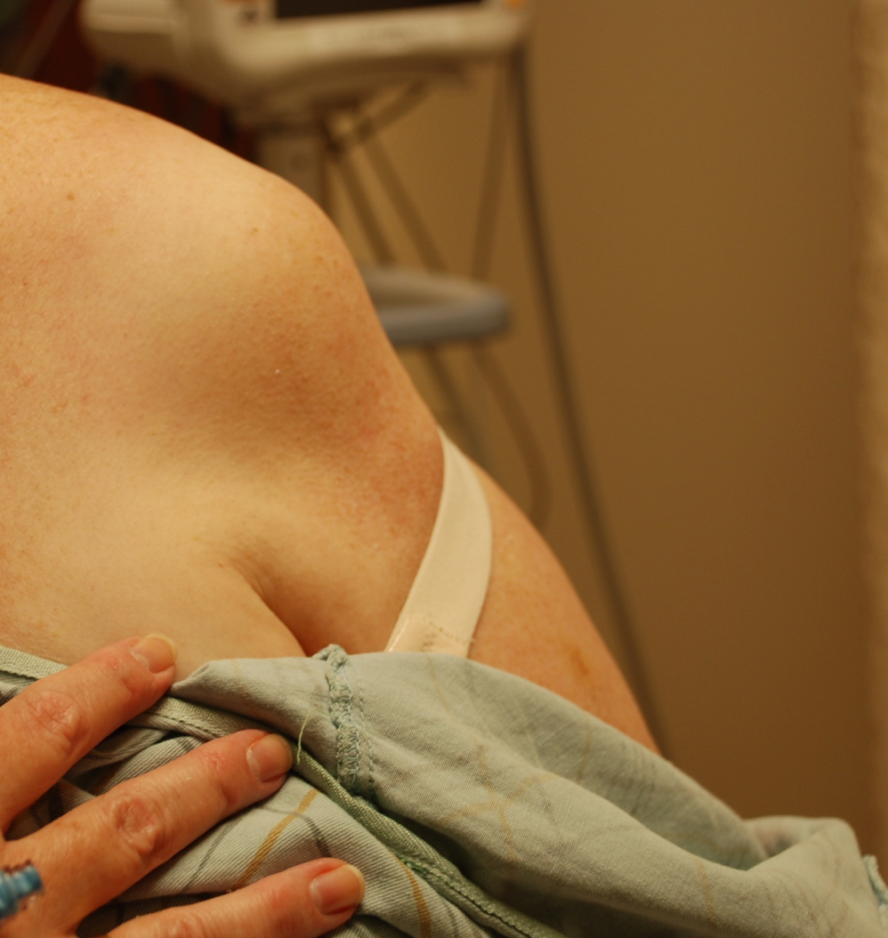
Inspection
Usually normal in the shoulder exam with a few notable exceptions
Squared off shoulder: anterior shoulder dislocation
Look for signs of infection (redness, swelling, warmth): think septic joint
Anterior shoulder dislocation

Slide 4
Palpation
Palpate the entire shoulder joint looking for point tenderness or deformity
Sternoclavicular joint
Clavicle
Acromioclavicular joint (may be tender at baseline)
Humeral head
Bicipital tendon in bicipital groove
Arm at 90 degrees, externally rotate to feel the tendon moving (may be tender)
Palpation of bicipital tendon in groove

Slide 5
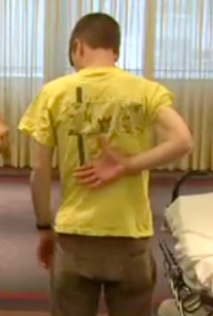
Range of Motion
Know what normal ranges are
Forward Flexion: 150-170º
Extension: 50-70º
External rotation: about 90º
Internal rotation: place hands behind the back with palm out
Measure level of spinous process of thumb
Normal is above T7
Compare both sides (dominant hand usually is 2 spinous process below non-dominant hand)
Internal Rotation

Slide 6
ROM (continued)
If normal active ROM, probably no mechanical limitation
Can basically rule out:
Humeral head fracture
Dislocation
Adhesive capsulitis (frozen shoulder)
If passive ROM preserved, but pt has impaired active ROM, think of pain-limited injury
Rotator cuff pathology
Bursitis
Tendonitis

Slide 7
Strength Testing
Rotator Cuff Muscles
Supraspinatus
Infraspinatus
Teres minor
Subscapularis
Hint for rotator cuff muscle actions
Remember that supraspinatus, teres minor and infraspinatus insert on post surface of scapula; subscapularis inserts on the anterior surface of the scapula

Slide 8
Strength Testing: Supraspinatus
Supraspinatus: abduction (with deltoid)
Empty Beer can Test
Arm to 90º, forward flexion to 30º, internal rotation of hand with thumbs down, push up against resistance

Slide 9
Strength Testing: Teres minor/infraspinatus
Teres minor/infraspinatus: external rotation
External rotation against resistance

Slide 10
Strength Testing: Subscapularis
Subscapularis: internal rotation
Internal rotation against resistance

Slide 11
Special Tests
AC joint Injury
Cross-arm test
Impingement: rotator cuff tendonitis, subacromial bursitis:
Look for pain when performing these maneuvers (these maneuvers push the humeral head against the acromion thereby pinching tendons)
Neer’s Test
Hawkin’s Test
Other Special Tests
Speed’s Test
O’Brien’s Test
Shoulder Apprehension Test

Slide 12
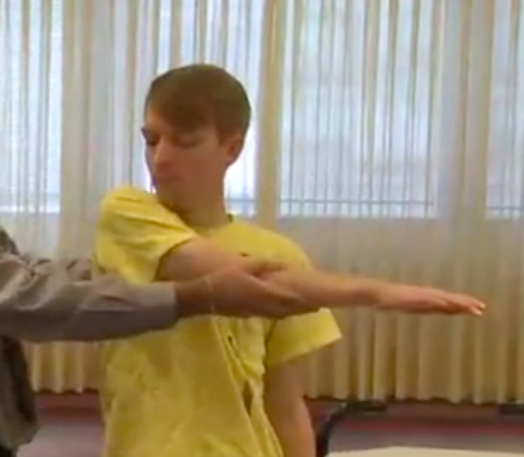
AC Injury: Cross-Arm Test
Pull arm across body (thereby compressing the AC joint)
look for pain at the AC joint not just general shoulder pain

Slide 13
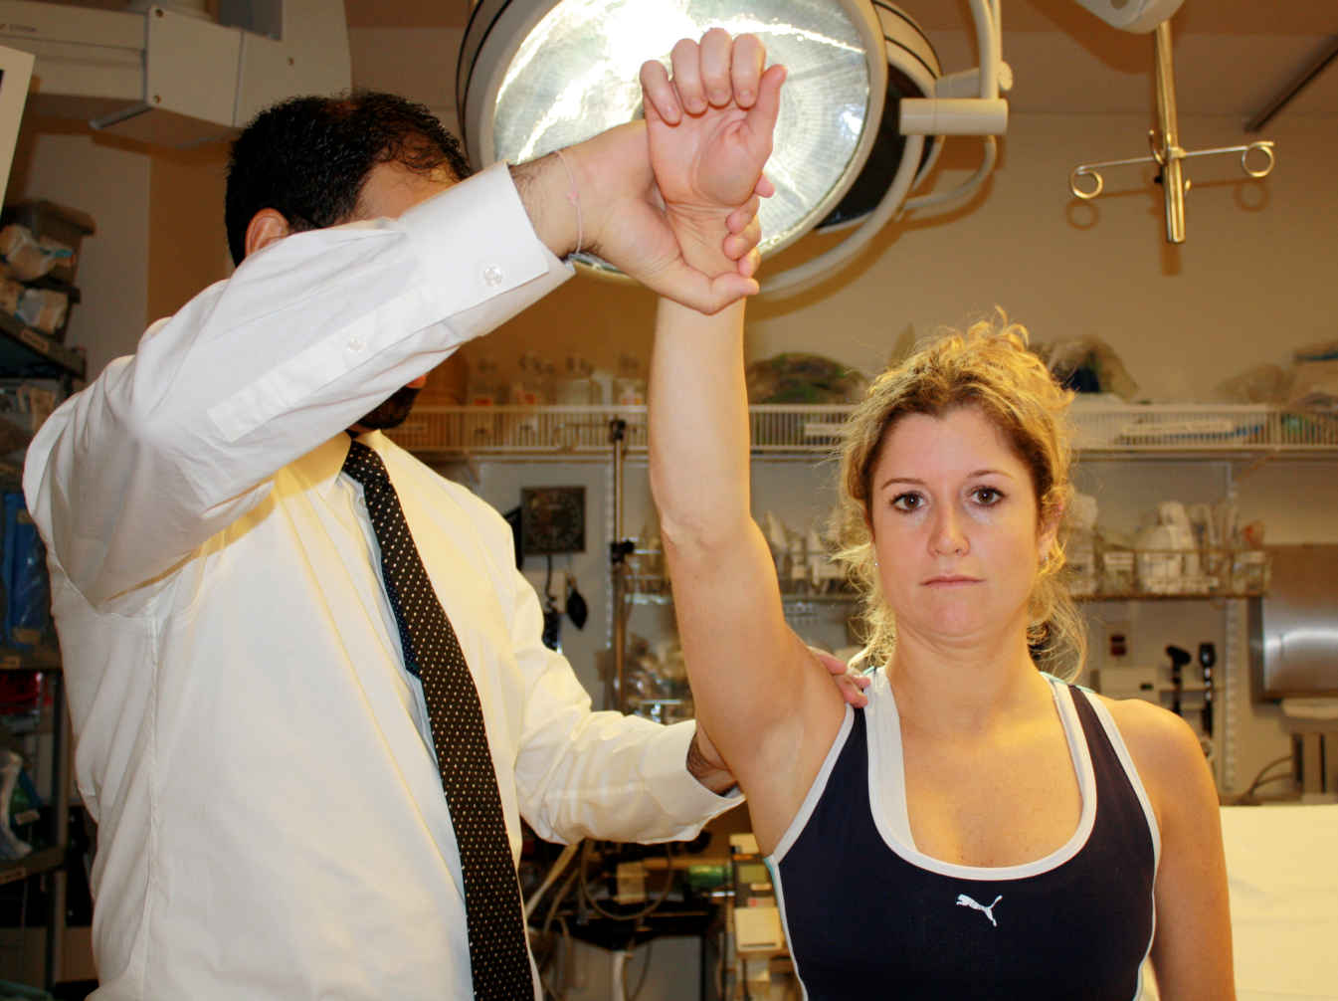
Impingement Tests: Neer’s Test
Forward flexion with arm internally rotated

Slide 14
Impingement Tests: Hawkins Test
Arm at 90º, 30º of forward flexion, bend elbow and take from external rotation to internal rotation

Slide 15
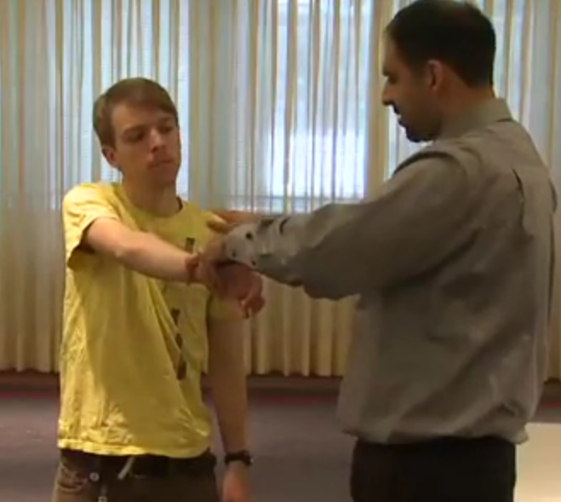
Other Special Tests: O’Brien’s Test
Labrum tears
Arm at 90º, flexed at 90º, bring arm across midline and then up against resistance
Internally rotated (thumb down)-> if pain, labrum tear
Externally rotated (thumb up) -> if pain, biceps pathology

Slide 16
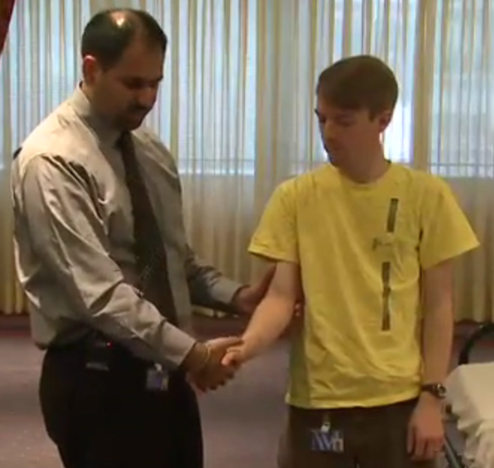
Other Special Tests: Speed’s Test
Biceps injury
Grab hand as if handshake and do resisted supination, look for pain

Slide 17
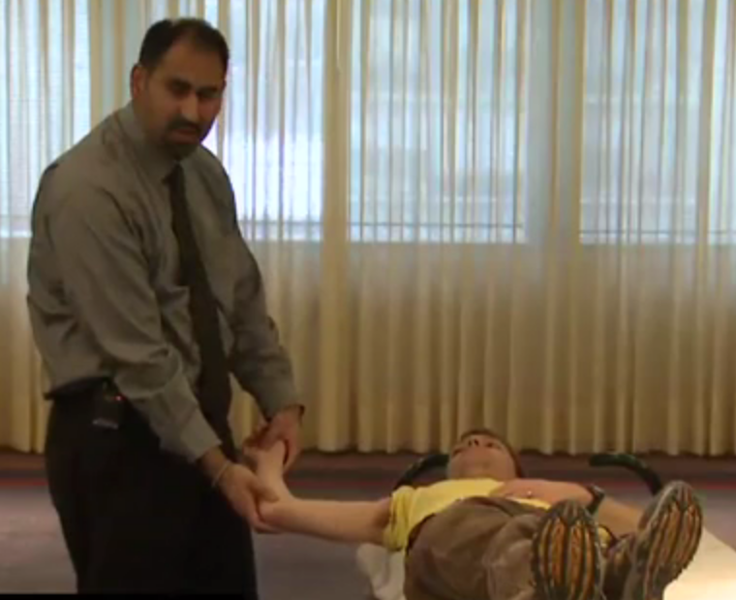
Other Special Tests: Apprehension Test
Shoulder stability (for recurrent dislocators)
patient supine, arm abducted 90º, elbow flexed to 90º, external rotation to 90º -> patient will feel pressure at the humerus
If you push down on the humeral head, will decrease pain and increase stability

