Slide 1
Procedures:
Splinting
Northwestern EM ortho curriculum

Slide 2
Indications for Splinting
Acute arthritis, including acute gout
Severe contusions and abrasions
Skin lacerations that cross joints
Tendon lacerations
Tenosynovitis
Puncture wounds/bites to the hands, feet, and joints
Fractures and sprains
Reduced joint dislocations

Slide 3
Splinting Equipment
Stockinette
Splinting material
  Plaster of Paris (at NMH)
    Strips or rolls (2-, 3-, 4- or 6-inch widths)
  Prefabricated Splint Rolls
    Plaster
    Fiberglass with polypropylene padding (at CMH)
Padding (Webril)
Ace Wrap
Bucket/receptacle of warm water
Trauma sheers

Slide 4
Plaster Preparation
Length: Measure out the dry splint at the extremity to be splinted
  remember the plaster shrinks slightly when wet, if too long, the ends can be folded back
  Use plaster width that is slightly greater than the diameter of the limb
  Can be measured on the contralateral extremity to avoid excessive manipulation of the injured extremity
Thickness:
  UE: 8-10 layers
  LE 10-12 layers

Slide 5
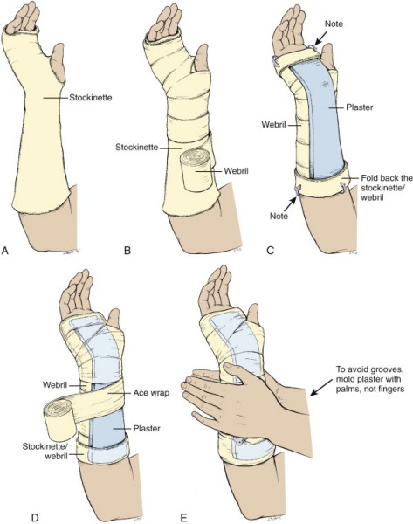
General Splinting Procedure
Stockinette is applied
Webril is applied
The wet plaster is positioned
Elastic bandage is applied
The plaster is molded

Slide 6
General Splinting Procedure
Measure and prepare the plaster
Apply the stockinette so that it extends 2 or 3 inches beyond the plaster
Apply 2 or 3 layers of Webril over the area to be splinted
  Be generous
  Avoid wrinkles
  Place extra padding around bony prominences
  Place Webril between digits that are going to be splinted to avoid maceration
Wet the plaster and place it over the area to be splinted
  Submerge the premeasured plaster in unused warm water
  Remove the splint from the water and squeeze out the excess water and remove wrinkles
Fold the ends of stockinette over the the plaster to smooth the edges of the splint

Slide 7
General Splinting Procedure (cont’d)
Place a layer of Webril over the plaster
Apply the ace wrap around the splint to secure it in place
  Unwrap the bandage without placing too much tension around the extremity
While still wet, mold the plaster to conform to the shape of the extremity
  Use the palms of your hand rather than the fingers
Place the patient’s extremity in the position desired
  Keep the patient still until the splint has dried and hardened (the plaster will become warm as it’s drying)
  Fast-drying: 5-8 minutes
  Extra-fast drying: 2-4 minutes
After the splint has dried, check the splinted extremity for function, arterial pulse, capillary refill, temperature of skin, and sensation

Slide 8
Specific Splints
Upper Extremity
Lower Extremity
Long arm posterior splint
Double sugar tong splint
Volar splint
Sugar tong splint
Thumb spica splint
Ulnar gutter splint
Radial gutter splint
Finger splints
Posterior knee splint
Jones compression dressing
Posterior ankle splint
U-splint/stirrup splint

Slide 9
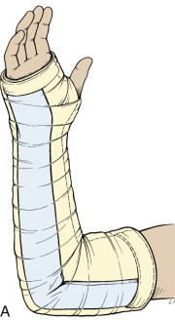
Long Arm Posterior Splint
Indications
  Injuries of the elbow and proximal forearm
Construction
  Starts on the posterior aspect of the proximal arm
  Down the ulnar aspect of arm
  Ends at the MCP joints
Application/Positioning
  Cut hole in stockinette for thumb
  Elbow at 90 degrees
  Forearm neutral position with thumb up
  Neutral or slightly extended wrist (10 -20 degrees)

Slide 10
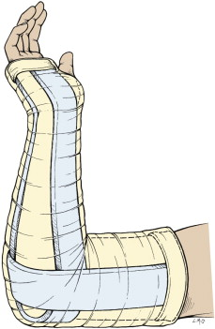
Double Sugar Tong
Indications
  Complex and unstable forearm and elbow fractures
Construction
  Forearm splint –from MC heads on the dorsal hand, around elbow to volar MCP joints
  Arm splint – from anterior proximal humerus, around elbow, to posterior arm to prox humerus
Application/Positioning
  Cut hole in stockinette for thumb
  Elbow at 90 degrees
  Forearm neutral with thumb up
  Slightly extended wrist (10 -20 degrees)

Slide 11
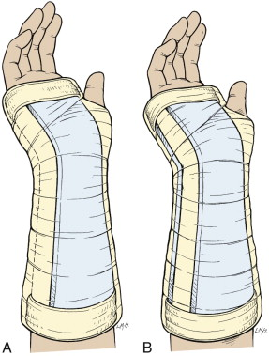
Volar Splint
Indications
  Soft tissue injuries of the hand and wrist
  Carpal bone fractures, 2nd – 5th MC head fractures
Construction
  Starts in the palm at the MC heads, down the volar aspect of forearm to distal forearm
Application/Positioning
  Cut hole in stockinette for thumb
  Forearm in neutral position with thumb up
  Wrist slightly extended (10-20 degrees)

Slide 12
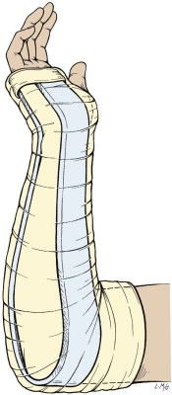
Sugar Tong Splint
Indications
  Distal radius and ulna fractures
Construction
  From MC heads on the dorsal hand, around elbow to volar MCP joints
Application/Positioning
  Cut hole in stockinette for thumb
  Elbow at 90 degrees
  Forearm neutral with thumb up
  Slightly extended wrist (10 -20 degrees)

Slide 13
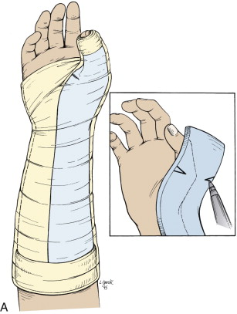
Thumb Spica Splint
Indications
  Injuries to scaphoid, lunate, thumb and 1st metacarpal
  Gamekeeper’s thumb
  De Quervain tenosynovitis
Construction
  From just distal to the interphalangeal joint of thumb to mid-forearm
Application/Positioning
  Cut hole in stockinette for thumb
  Forearm in neutral position with thumb in wineglass position

Slide 14
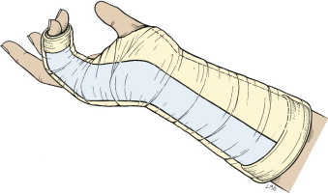
Ulnar Gutter Splint
Indications
  Fractures and soft tissue injuries of 5th digit
  Fractures of the neck, shaft, and base of 4th and 5th metacarpals.
Construction
  Starts at mid-forearm, runs along ulnar aspect of forearm to just beyond the DIP joint
  Include the 4th and 5th digits
Application/Positioning
  Forearm in neutral
  Slight wrist extension (10-20 degrees)
  PIP and DIP joints 10-15 degrees of flexion
  50 degrees of flexion of MCP joints
  If Boxer’s fracture -> MCP joint flexed to 90 degrees

Slide 15
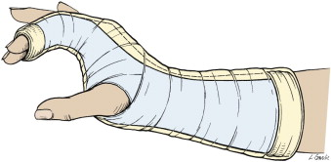
Radial Gutter Splint
Indications
  Fractures and soft tissue injuries of index and 3rd digits
  Fractures of the neck, shaft and base of the 2nd and 3rd metacarpals
Construction
  Starts at mid-forearm, down the radial aspect of forearm to just distal to the DIP joint of 2nd and 3rd digits
Application/Positioning
  Cut hole in stockinette and plaster for the thumb
  Hand in position of function
  Forearm in neutral position
  Wrist slightly extended
  MCP 50 degrees of flexion
  PIP and DIP joints 5 to 10 degrees of flexion

Slide 16
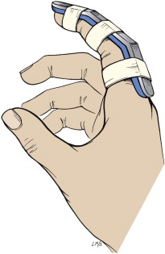
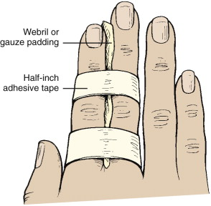
Finger Splints
Buddy tape
  Indications: minor finger sprains
Aluminum finger splints
  Phalanx fractures
  After tendon repairs

Slide 17
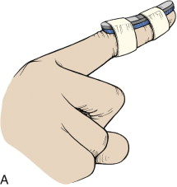
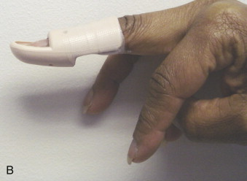
Finger Splints for Mallet Finger
Indication
  Mallet Finger
Construction
  Splint only the DIP joint
Application/Positioning
  Splint DIP joint in hyperextension
  Cannot be removed for 6-8 weeks

Slide 18
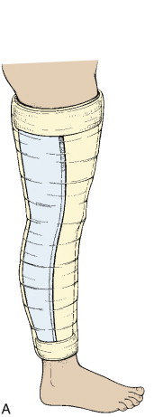
Posterior Knee Splint
Indications
  Patients with legs too large for knee immobilizer
  Angulated fractures
  Injuries that require urgent operative fixation
Construction
  Starts just below buttocks crease on dorsal aspect of leg to 5 to 8 cm above the malleoli
Application/Positioning
  Slightly flexed knee (especially in kids so they don’t bear weight)

Slide 19
Jones Compression Dressing
Indications
  Short-term immobilization of soft tissue injuries of knee
  Not for injuries that require strict immobilization
Construction
  Webril and Ace wrap from the groin to a few inches above the malleoli
  2 to 3 layers of webril
Application
  Slight flexion of the knee

Slide 20
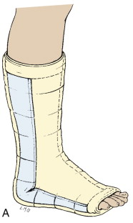
Posterior Ankle Splint (Post Mold)
Indications
  Severe ankle sprains
  Fractures of distal fibula and tibia
  Reduced ankle dislocations
  Can add stirrup splint for unstable ankle fractures
Construction
  From plantar surface of the metatarsal heads to the level of the fibular head posteriorly
Application/Positioning
  Most easily applied in the prone position
  Ankle to 90 degrees

Slide 21
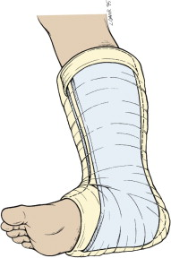
U-Splint/Stirrup Splint
Indications
  Severe ankle sprains
  Fractures of distal fibula and tibia
  Reduced ankle dislocations
  Can be added to post mold for unstable ankle fracture
Construction
  Passes under the plantar surface of foot and extends up medial and lateral sides of leg to just below level of fibular head
Application/Positioning
  Most easily applied in the prone position
  Ankle to 90 degrees
  If placed with post mold, place post mold first

